Slide 1
Learning as Representaional Shift in mouse visual cortex

Slide 2
ophys
Drifting gratings
6 visual areas
175-600 um

Slide 3
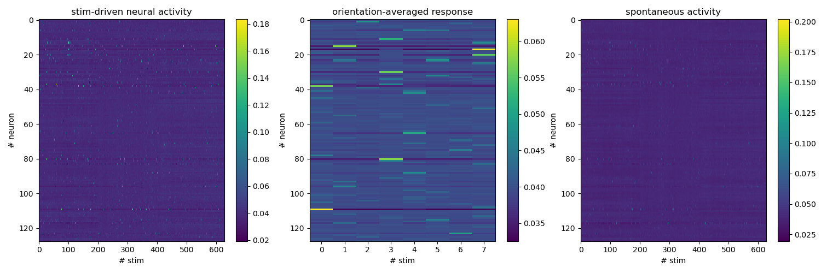
Response
2s after the stimulus onset
Notes:
Population vector

Slide 4
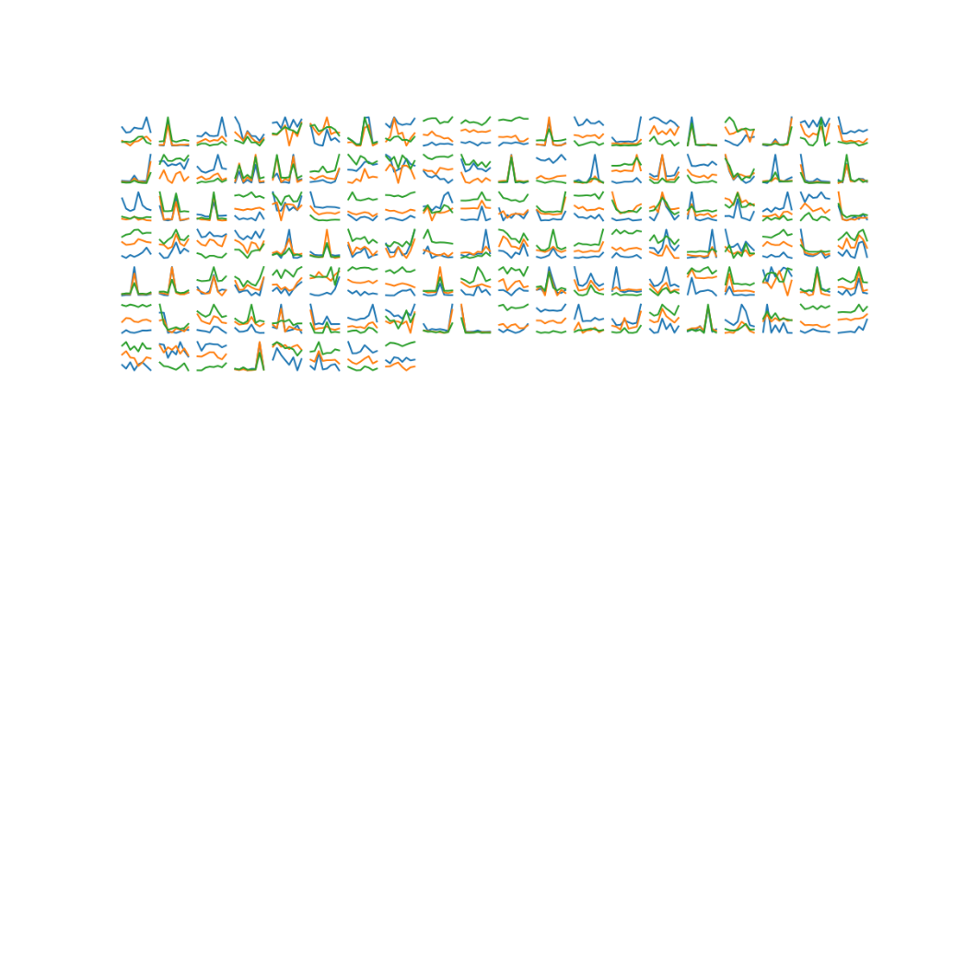
Tunning curves

Slide 5
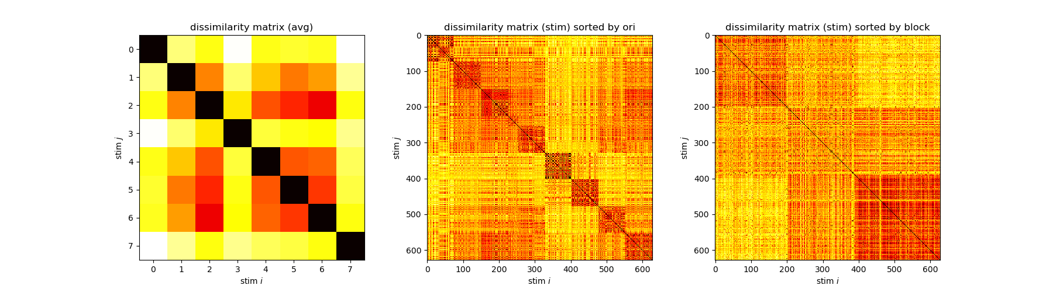
Dissimilarity matrix
Notes:
Low dimensional tSNE embedding based on the euclidean dissimilarity matrix
This example session shows orientation clustering together with changes between blocks

Slide 6
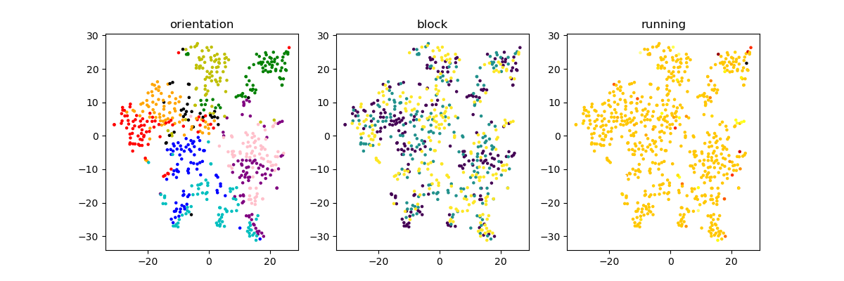
1. Orientation clustering (No block effect)
Example 617381603

Slide 7
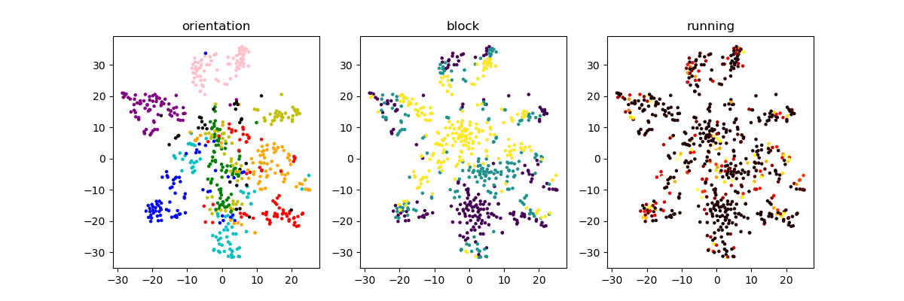
2. Block effect < orientation selectivity
Example 511510667

Slide 8
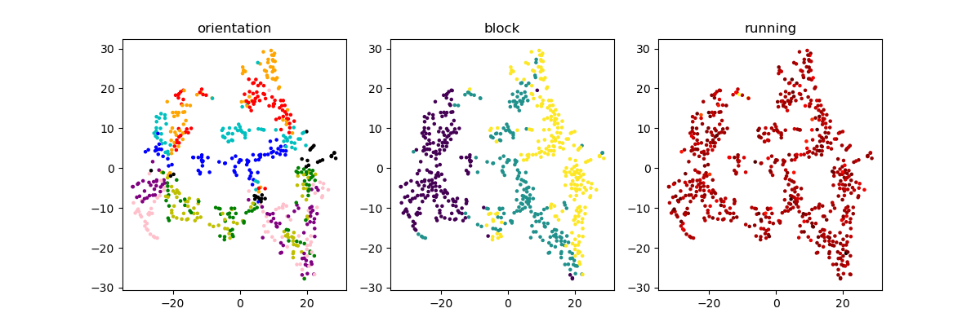
3. Block effect > orientation selectivity
Example 511510896

Slide 9
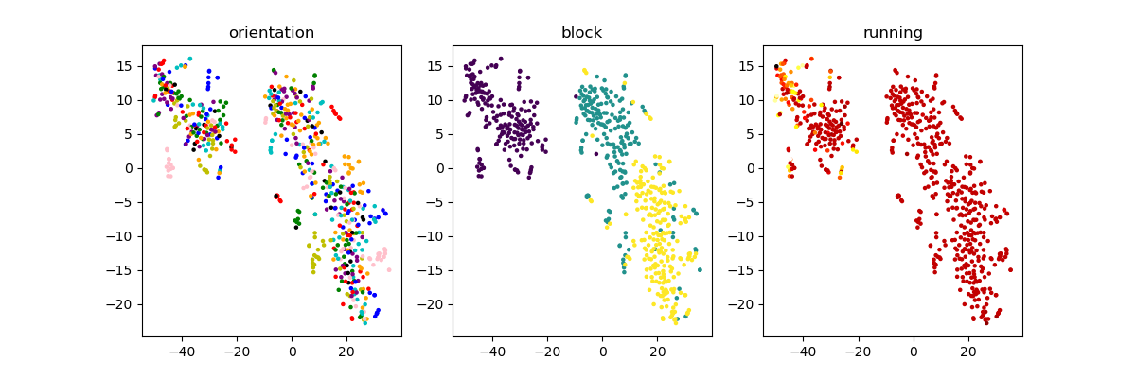
4. Block effect (No orientation clustering)
Example 540993888

Slide 10
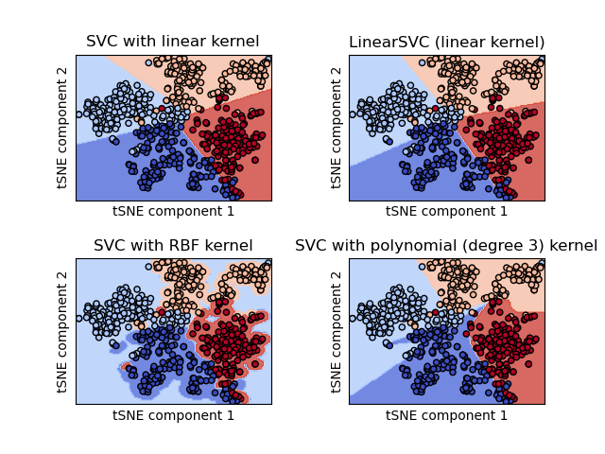
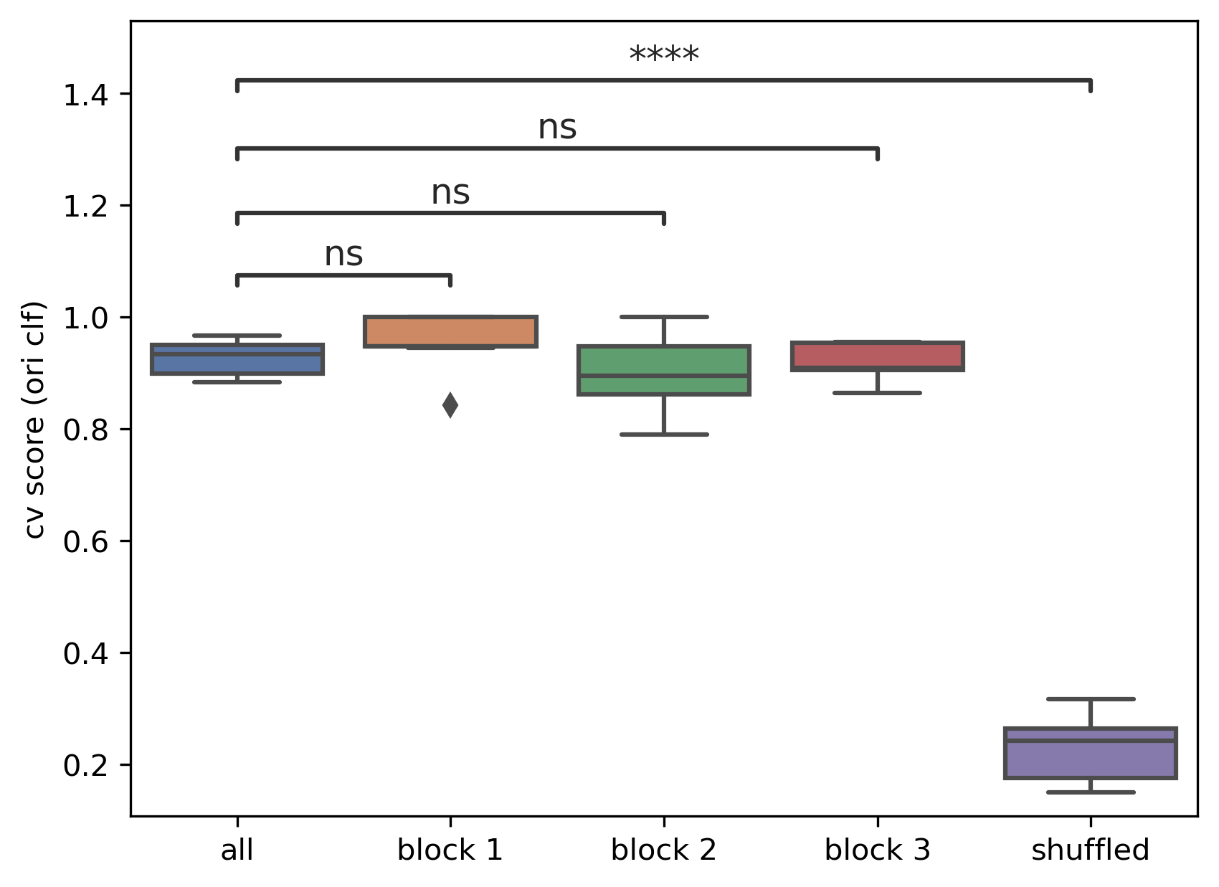
Quantify with SVM (ori clf)
Notes:
617381603 (1)

Slide 11
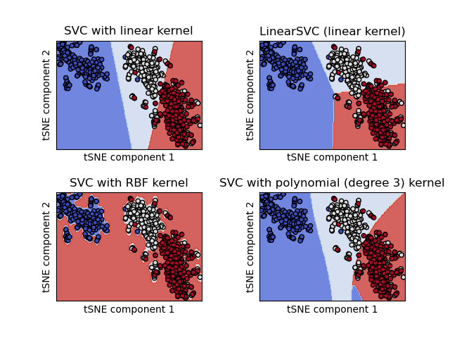
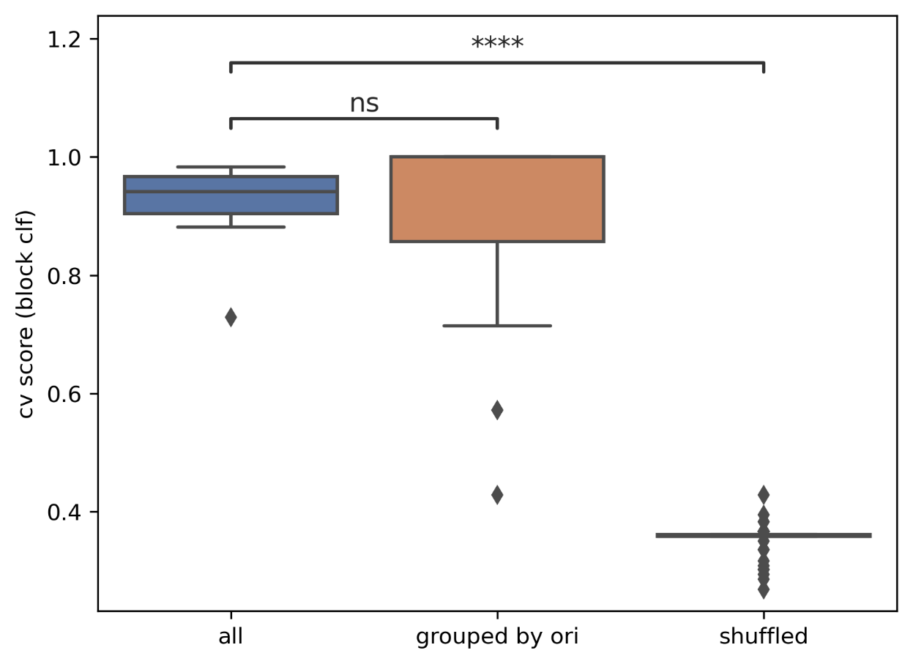
Quantify with SVM (block clf)
Notes:
540993888 (4)

Slide 12
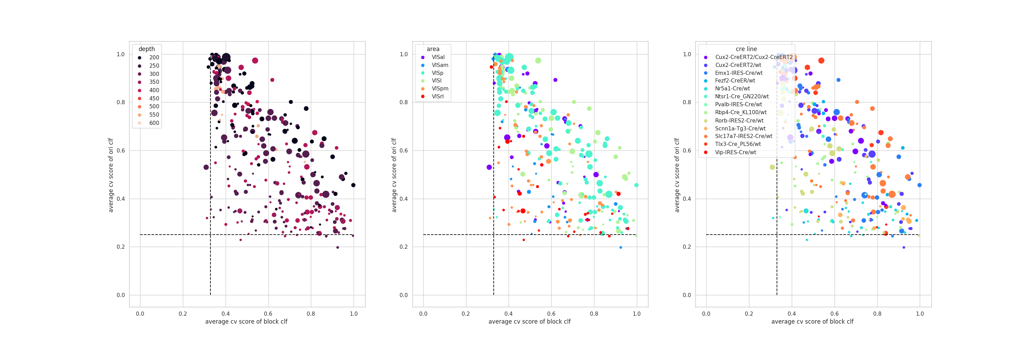
Scatter: ori clf cv score – block clf cv score
1
2
3
4
Notes:
Each dot is a session
Size of the dot is the number of identified neurons (ROI) in that session
Q: the neuron population in each session is heterogeneous, some are more block driven, some are more orientation selective; could that be the reason why the scatter plot doesn‘t show much since each session is summarized just by one dot.

Slide 13
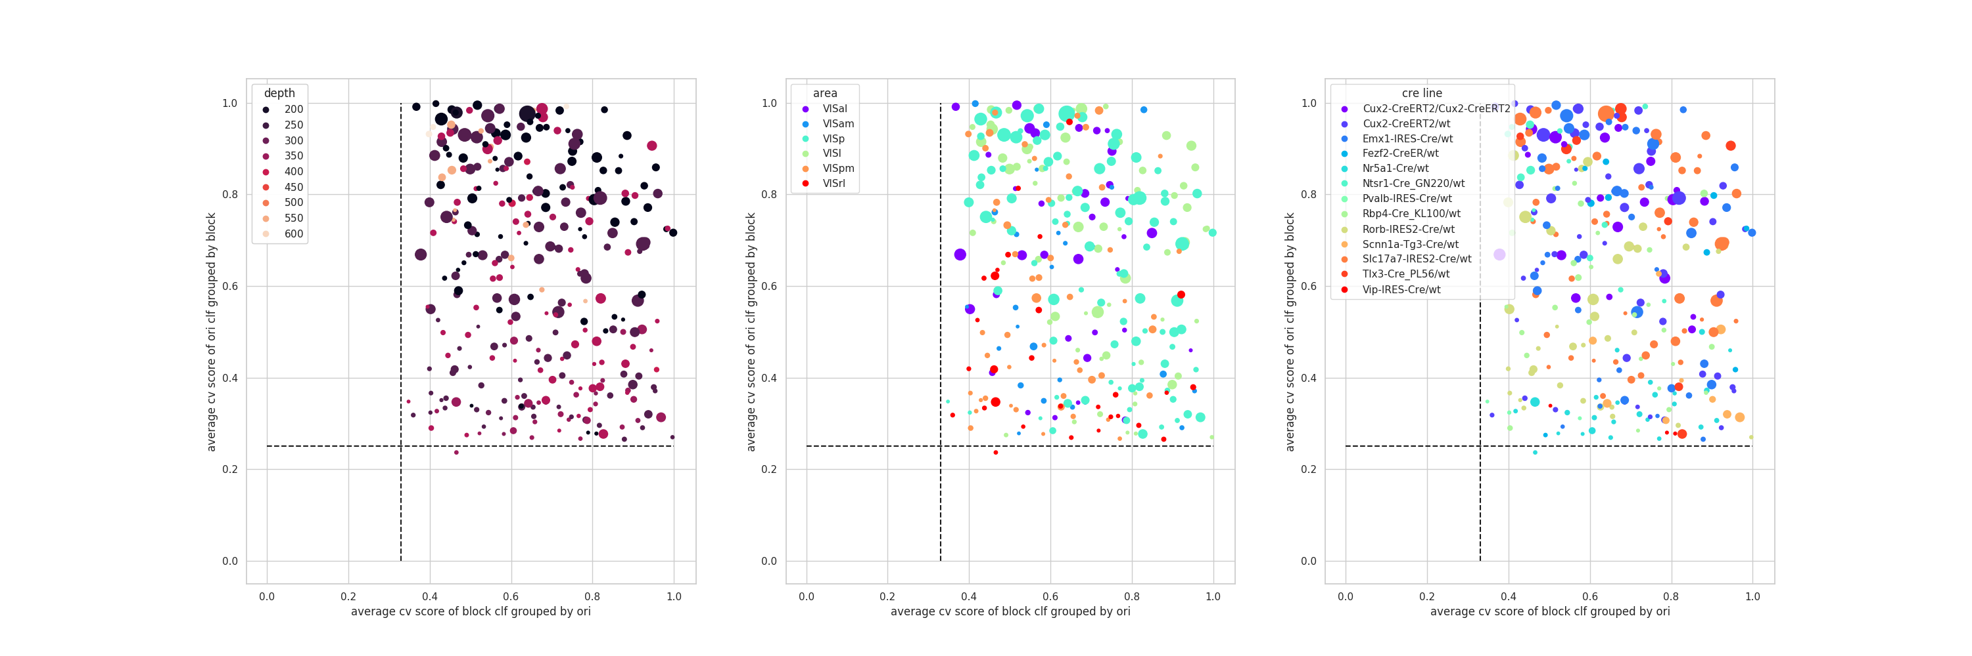
Scatter: ori clf avg cv score (grouped by block cluster) – block clf avg cv score (grouped by ori cluster)
1
2
3
4

Slide 14
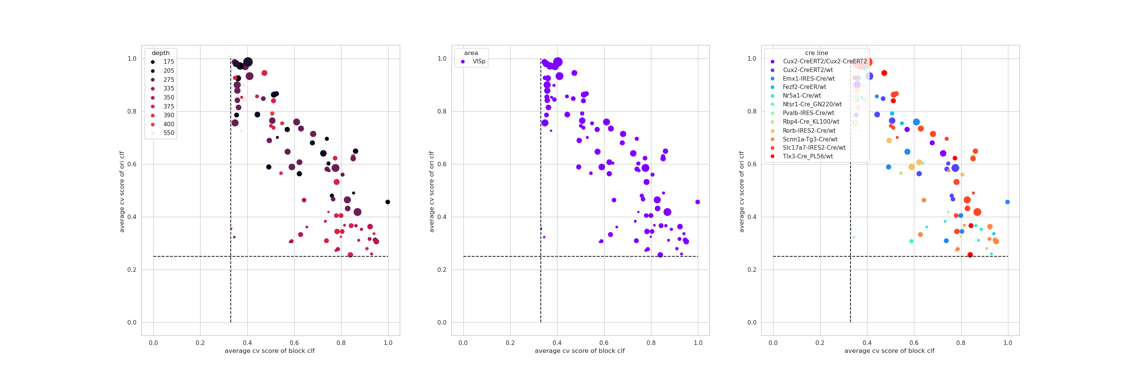
For each area

Slide 15
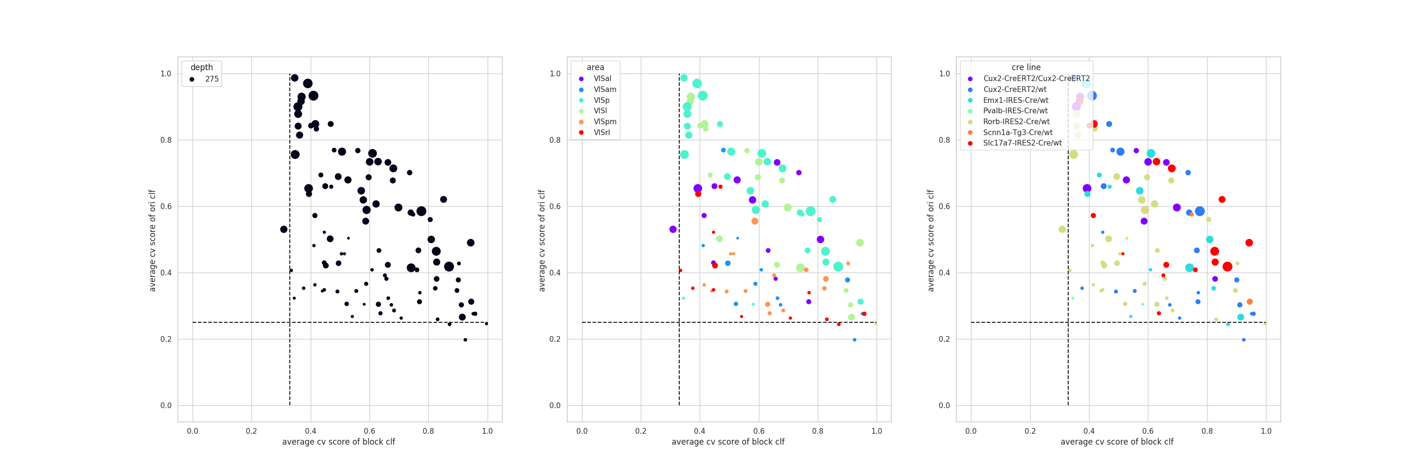
For each layer
Notes:
150-250 1
250-350 2/3
350-500 4
500-600 5

Slide 16
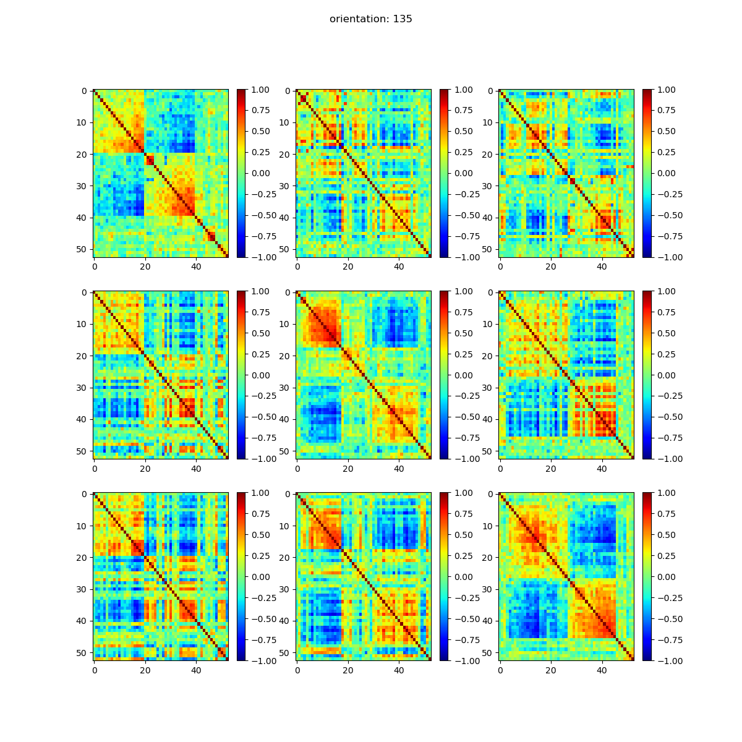
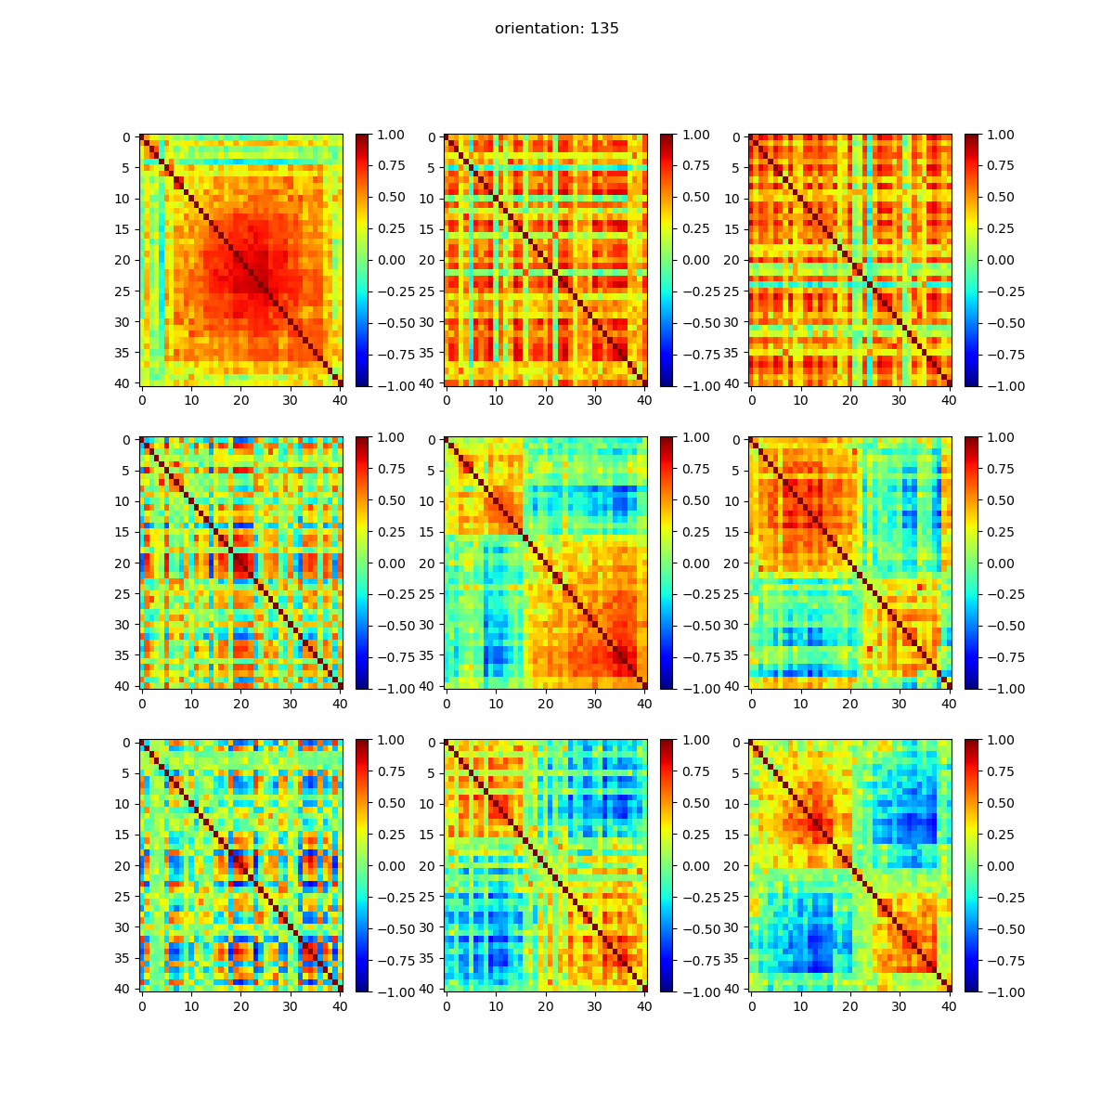
Reshape of noise correlation
No strong block effect
Strong block effect
Notes:
Noise correlation matrix is the same on each row for each block
The ordering of neurons is the same on each column based on hierarchical clustering

Slide 17
Summary

